Slide 1
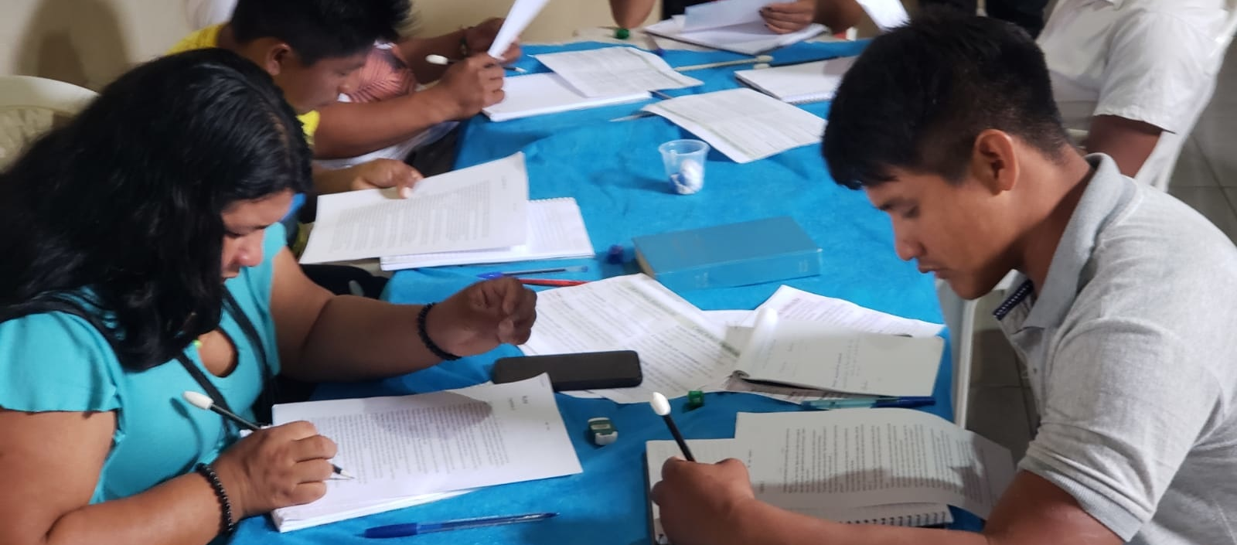
Using the New Testament Survey
Give to a wise person, and he will become even wiser; teach a righteous person, and he will add to his learning (Prov. 9:9).
All Scripture taken from the English Unlocked Literal Bible (ULB), ©2017, 2022 Wycliffe Associates, Available at https://bibleineverylanguage.org/translations, licensed under the Creative Commons Attribution-ShareAlike 4.0 International License.
The English ULB is based on the unfoldingWord® Literal Text, CC BY-SA 4.0. The original work of the unfoldingWord® Literal Text is available at https://unfoldingword.bible/ult/.

Slide 2

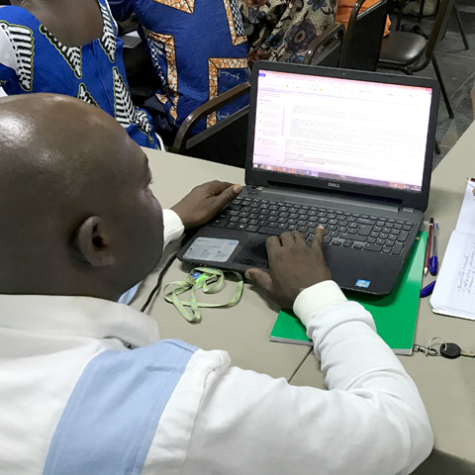
Bibleineverylanguage.org

Slide 3
?

Slide 4
Reviewers’ Guide New Testament Survey
Matthew 3:13-17
Background: After Jesus grew up, John the Baptist went into the wilderness and preached that people should stop sinning and be baptized. John also taught that someone more powerful than he would come, and that person would judge people.
Read the passage.

Slide 5
Matthew 3:13-17 Text
Then Jesus came from Galilee to the Jordan River to be baptized by John. ¹⁴ But John kept trying to stop him, saying, "I need to be baptized by you, and do you come to me?" ¹⁵ Jesus responded and said to him, "Permit it now, for it is right for us to fulfill all righteousness." Then John permitted him. ¹⁶ After he was baptized, Jesus came up immediately from the water, and behold, the heavens were opened to him. He saw the Spirit of God coming down like a dove and resting upon him. ¹⁷ Behold, a voice came out of the heavens saying, "This is my beloved Son. I am very pleased with him."

Slide 6
Reviewers’ Guide New Testament Survey
Matthew 3:13-17
Background: After Jesus grew up, John the Baptist went into the wilderness and preached that people should stop sinning and be baptized. John also taught that someone more powerful than he would come, and that person would judge people.
Read the passage.
Part 1
Tell in your own words what you just read in this passage.
☐ Jesus came to the Jordan River to be baptized by John. [3:13]
☐ John tried to stop Jesus, but Jesus said it was right for John to baptize him. [3:14-15]
☐ After John baptized Jesus, God’s Spirit came down like a dove and rested on Jesus. [3:16]
☐ A voice from heaven said, “This is my beloved Son. I am very pleased with him.” [3:17]

Slide 7
Reviewers’ Guide New Testament Survey
Matthew 3:13-17, Continued
Part 2
Answer the following questions from the specified verses.
1. [3:14] When Jesus came to be baptized, what did John tell Jesus?
John told Jesus that he needed to be baptized by Jesus.
2. [3:15] What did Jesus say was the reason that John should baptize him?
It was right for them to fulfill all righteousness.
3. [3:16] What did the Spirit of God do when Jesus came out of the water?
The Spirit of God came down and rested on Jesus.
4. [3:17] What did the voice from heaven say after Jesus came out of the water?
The voice said, “This is my beloved Son. I am very pleased with him.”

Slide 8
Reviewers’ Guide New Testament Survey
Matthew 3:13-17, Continued
Part 2
Answer the following questions from the specified verses.
1. [3:14] When Jesus came to be baptized, what did John tell Jesus?
John told Jesus that he needed to be baptized by Jesus.
2. [3:15] What did Jesus say was the reason that John should baptize him?
It was right for them to fulfill all righteousness.
3. [3:16] What did the Spirit of God do when Jesus came out of the water?
The Spirit of God came down and rested on Jesus.
4. [3:17] What did the voice from heaven say after Jesus came out of the water?
The voice said, “This is my beloved Son. I am very pleased with him.”
5. [3:17] Whose voice do you think was speaking?
By saying the voice came out of heaven, the passage shows that it was the voice of God the Father.
6. [3:17] Who do you think God the Father was speaking about in verse 17?
The passage shows that he was speaking about Jesus.

